Slide 1


Restaurant & Consumer Data
Presented By: Akshith Chidurala Pavan Adithya

Slide 2

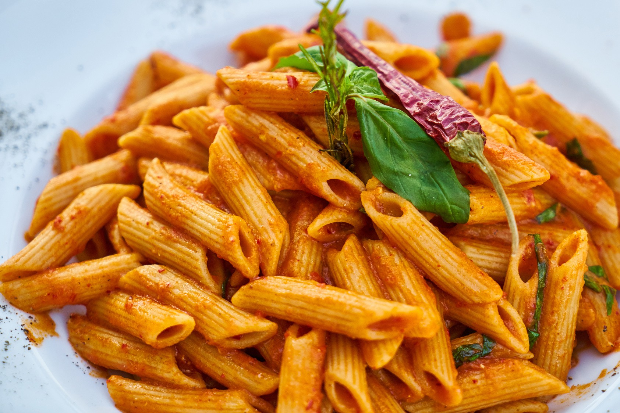
RESTAURANT & CONSUMER DATA

Slide 3
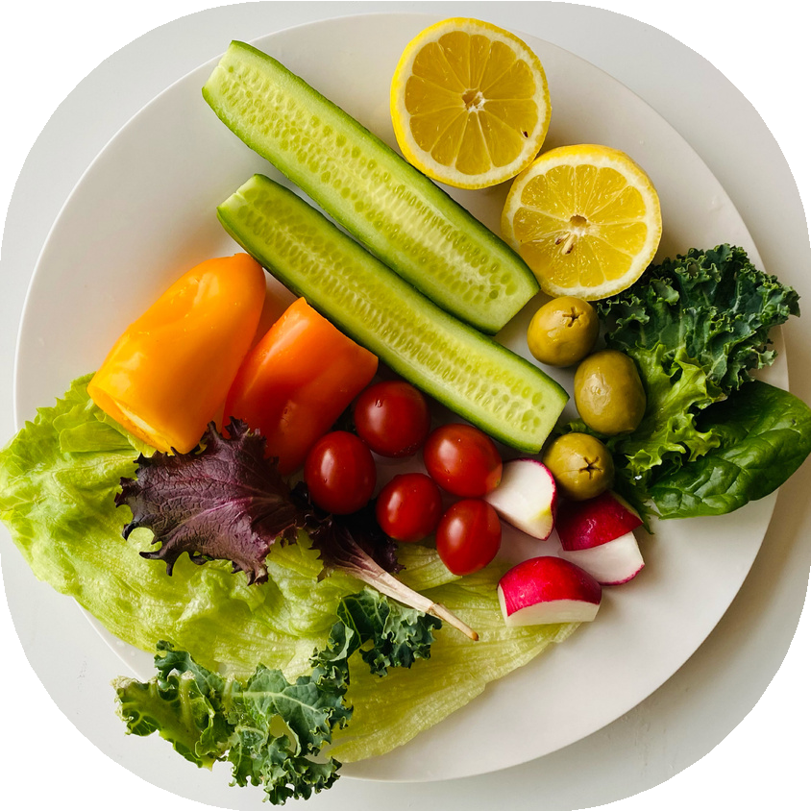
INTRODUCTION
This project focuses on designing and analyzing a comprehensive Restaurant & Consumer Analytics Database using MySQL Workbench. The system integrates consumer demographics, restaurant information, cuisines served, and detailed rating data to derive meaningful insights.
A fully relational database schema was implemented using five core tables—CONSUMERS, CONSUMER_PREFERENCES, RESTAURANTS,
RESTAURANT_CUISINES, and RATINGS. The project includes a wide range of SQL concepts such as filtering, joins, aggregate functions, subqueries, CTEs, window functions, views, and stored procedures.
The objective of this project is to enable analysis of consumer behavior, restaurant performance, cuisine preferences, and rating trends. Through complex SQL queries, ranking logic, and reusable procedural components, the project demonstrates strong database design, analytical querying, and real-world data modeling skills.

Slide 4
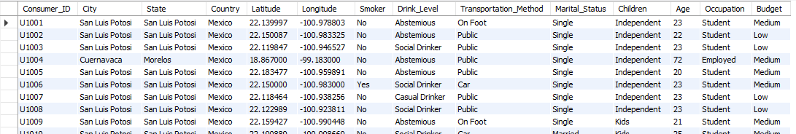
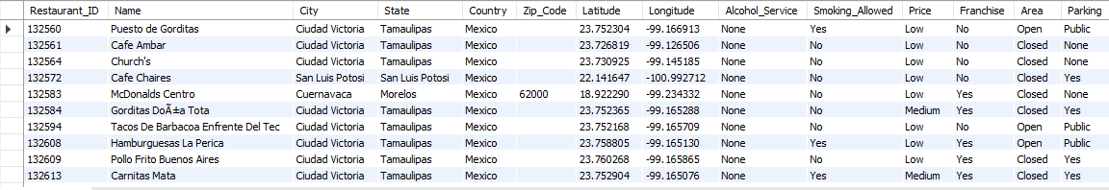
TABLES
CONSUMER TABLE
RESTAURANT TABLE

Slide 5
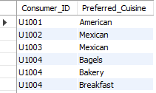
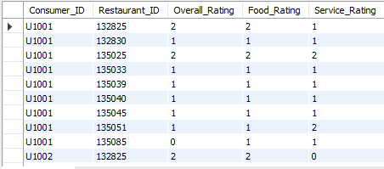
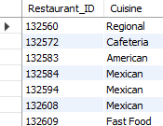
TABLES
CONSUMER_PREFERENCES TABLE
RATINGS TABLE
RESTAURANT_CUISINES TABLE

Slide 6
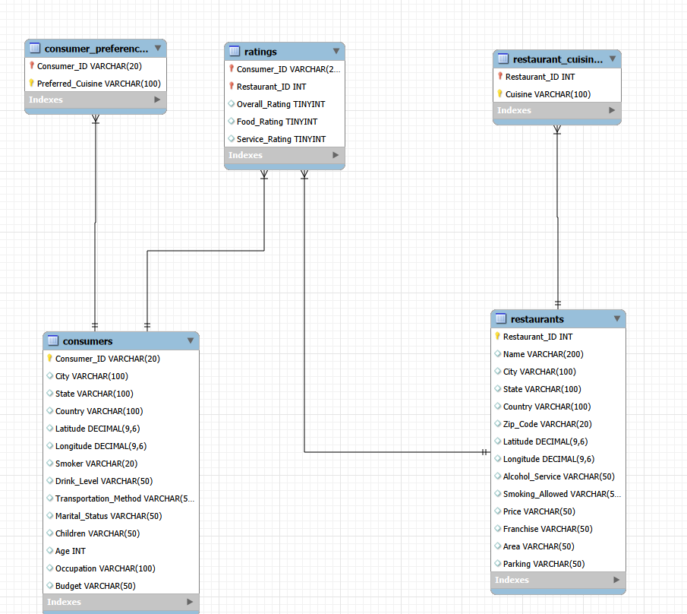


ER DIAGRAM

Slide 7

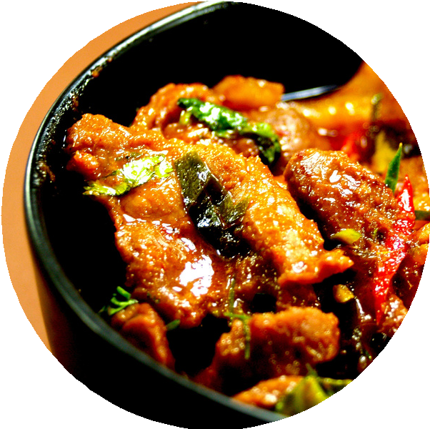
PROBLEM STATEMENT
Data related to consumers, restaurants, cuisines, and ratings is often unstructured and scattered. Without a unified system, it becomes difficult to analyze consumer preferences, identify high-performing restaurants, or understand rating patterns.
There is a need for a centralized SQL database that can store this information in an organized manner and support efficient analysis through queries, joins, aggregations, and advanced SQL techniques.
This project solves the problem by creating a structured relational database and performing detailed analytics using SQL.

Slide 8
SQL QUERIES
1. LIST ALL DETAILS OF CONSUMERS WHO LIVE IN THE CITY OF 'CUERNAVACA'.

Slide 9
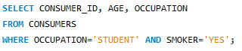

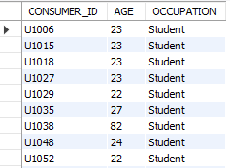
2. FIND THE CONSUMER_ID, AGE, AND OCCUPATION OF ALL CONSUMERS WHO ARE 'STUDENTS' AND ARE 'SMOKERS'.

Slide 10
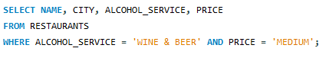

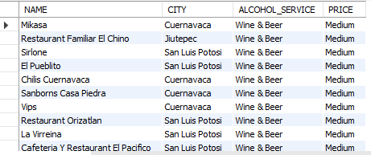
3. LIST THE NAME, CITY, ALCOHOL_SERVICE, AND PRICE OF ALL RESTAURANTS THAT SERVE 'WINE & BEER' AND HAVE A 'MEDIUM' PRICE LEVEL.

Slide 11
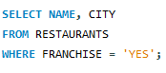

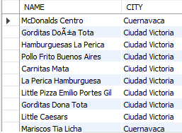
4.FIND THE NAMES AND CITIES OF ALL RESTAURANTS THAT ARE PART OF A 'FRANCHISE

Slide 12
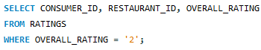
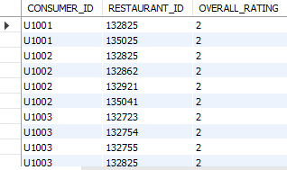

5. SHOW THE CONSUMER_ID, RESTAURANT_ID, AND OVERALL_RATING FOR ALL RATINGS WHERE THE OVERALL_RATING WAS 'HIGHLY SATISFACTORY' (WHICH CORRESPONDS TO A VALUE OF 2, ACCORDING TO THE DATA DICTIONARY).

Slide 13
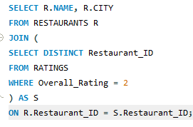
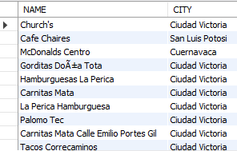

6. LIST THE NAMES AND CITIES OF ALL RESTAURANTS THAT HAVE AN OVERALL_RATING OF 2 (HIGHLY SATISFACTORY) FROM AT LEAST ONE CONSUMER.

Slide 14
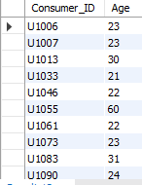
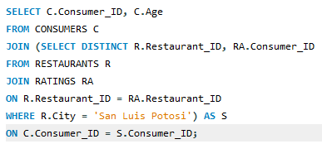

7.FIND THE CONSUMER_ID AND AGE OF CONSUMERS WHO HAVE RATED RESTAURANTS LOCATED IN 'SAN LUIS POTOSI'

Slide 15
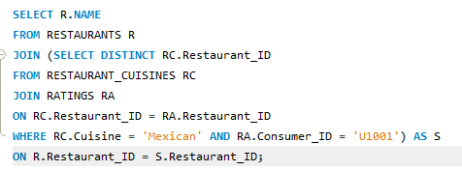

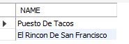

8.LIST THE NAMES OF RESTAURANTS THAT SERVE 'MEXICAN' CUISINE AND HAVE BEEN RATED BY CONSUMER 'U1001'.

Slide 16
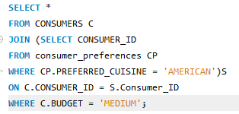


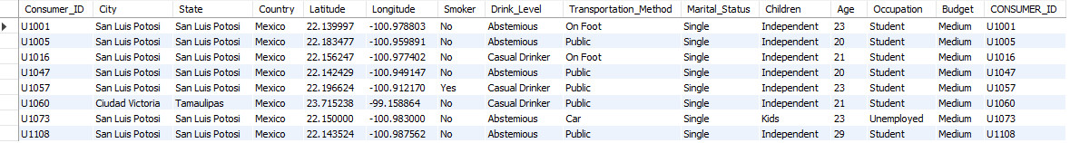
9.FIND ALL DETAILS OF CONSUMERS WHO PREFER 'AMERICAN' CUISINE AND HAVE A 'MEDIUM' BUDGET

Slide 17
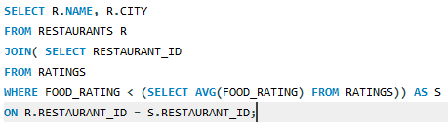
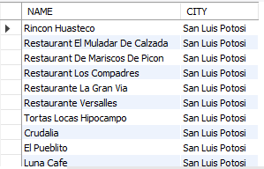

10. LIST RESTAURANTS (NAME, CITY) THAT HAVE RECEIVED A FOOD_RATING LOWER THAN THE AVERAGE FOOD_RATING ACROSS ALL RATED RESTAURANTS.

Slide 18

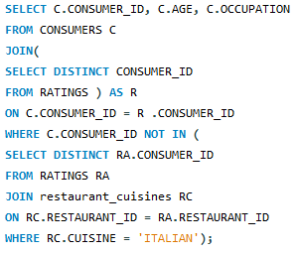
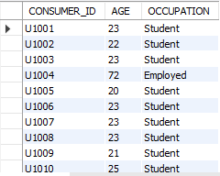

11.FIND CONSUMERS (CONSUMER_ID, AGE, OCCUPATION) WHO HAVE RATED AT LEAST ONE RESTAURANT BUT HAVE NOT RATED ANY RESTAURANT THAT SERVES 'ITALIAN' CUISINE.

Slide 19
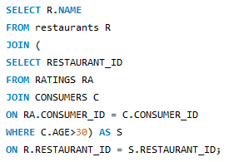
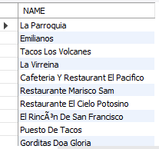

12. LIST RESTAURANTS (NAME) THAT HAVE RECEIVED RATINGS FROM CONSUMERS OLDER THAN 30.

Slide 20
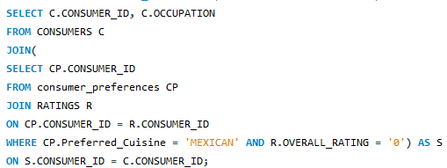
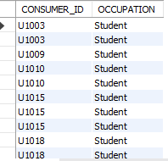


13. FIND THE CONSUMER_ID AND OCCUPATION OF CONSUMERS WHOSE PREFERRED CUISINE IS 'MEXICAN' AND WHO HAVE GIVEN AN OVERALL_RATING OF 0 TO AT LEAST ONE RESTAURANT (ANY RESTAURANT).

Slide 21
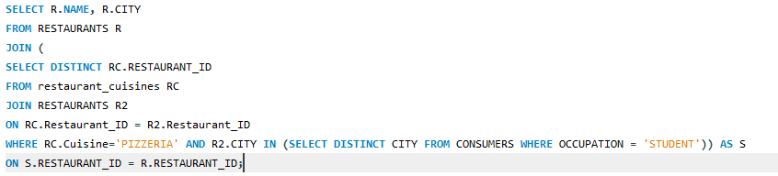

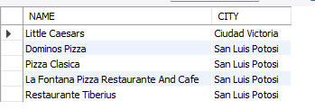
14. LIST THE NAMES AND CITIES OF RESTAURANTS THAT SERVE 'PIZZERIA' CUISINE AND ARE LOCATED IN A CITY WHERE AT LEAST ONE 'STUDENT' CONSUMER LIVES.

Slide 22
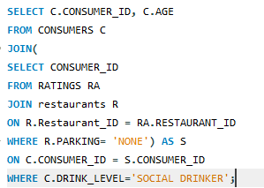
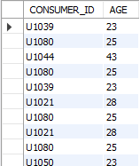


15.FIND CONSUMERS (CONSUMER_ID, AGE) WHO ARE 'SOCIAL DRINKERS' AND HAVE RATED A RESTAURANT THAT HAS 'NO' PARKING.

Slide 23
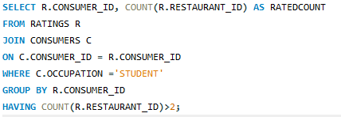
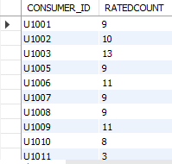

16. LIST CONSUMER_IDS AND THE COUNT OF RESTAURANTS THEY'VE RATED, BUT ONLY FOR CONSUMERS WHO ARE 'STUDENTS'. SHOW ONLY STUDENTS WHO HAVE RATED MORE THAN 2 RESTAURANTS.

Slide 24
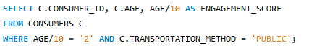

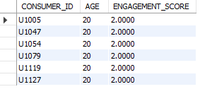
17. WE WANT TO CATEGORIZE CONSUMERS BY AN 'ENGAGEMENT_SCORE' WHICH IS THEIR AGE DIVIDED BY 10 (INTEGER DIVISION). LIST THE CONSUMER_ID, AGE, AND THIS CALCULATED ENGAGEMENT_SCORE, BUT ONLY FOR CONSUMERS WHOSE ENGAGEMENT_SCORE WOULD BE EXACTLY 2 AND WHO USE 'PUBLIC' TRANSPORTATION.

Slide 25
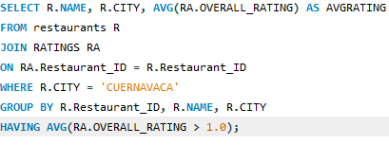

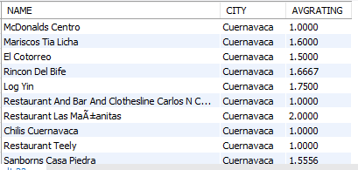

18. FOR EACH RESTAURANT, CALCULATE ITS AVERAGE OVERALL_RATING. THEN, LIST THE RESTAURANT NAME, CITY, AND ITS CALCULATED AVERAGE OVERALL_RATING, BUT ONLY FOR RESTAURANTS LOCATED IN 'CUERNAVACA' AND WHOSE CALCULATED AVERAGE OVERALL_RATING IS GREATER THAN 1.0.

Slide 26
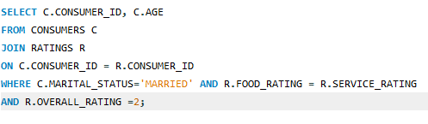
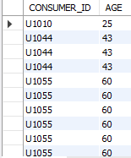

19. FIND CONSUMERS (CONSUMER_ID, AGE) WHO ARE 'MARRIED' AND WHOSE FOOD_RATING FOR ANY RESTAURANT IS EQUAL TO THEIR SERVICE_RATING FOR THAT SAME RESTAURANT, BUT ONLY CONSIDER RATINGS WHERE THE OVERALL_RATING WAS 2.

Slide 27
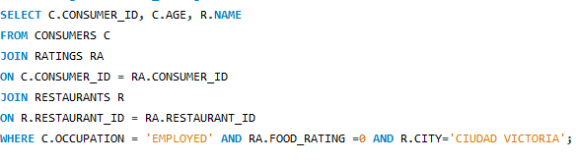
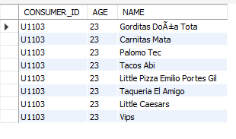

20. LIST CONSUMER_ID, AGE, AND THE NAME OF ANY RESTAURANT THEY RATED, BUT ONLY FOR CONSUMERS WHO ARE 'EMPLOYED' AND HAVE GIVEN A FOOD_RATING OF 0 TO AT LEAST ONE RESTAURANT LOCATED IN 'CIUDAD VICTORIA'.

Slide 28
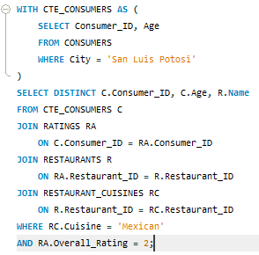
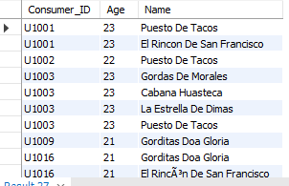

21..USING A CTE, FIND ALL CONSUMERS WHO LIVE IN 'SAN LUIS POTOSI'. THEN, LIST THEIR CONSUMER_ID, AGE, AND THE NAME OF ANY MEXICAN RESTAURANT THEY HAVE RATED WITH AN OVERALL_RATING OF 2.

Slide 29
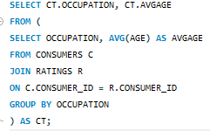


22. FOR EACH OCCUPATION, FIND THE AVERAGE AGE OF CONSUMERS. ONLY CONSIDER CONSUMERS WHO HAVE MADE AT LEAST ONE RATING.(USE A DERIVED TABLE TO GET CONSUMERS WHO HAVE RATED).

Slide 30



23. USING A CTE TO GET ALL RATINGS FOR RESTAURANTS IN 'CUERNAVACA', RANK THESE RATINGS WITHIN EACH RESTAURANT BASED ON OVERALL_RATING (HIGHEST FIRST).
DISPLAY RESTAURANT_ID, CONSUMER_ID, OVERALL_RATING, AND THE RATINGRANK.

Slide 31




24. FOR EACH RATING, SHOW THE CONSUMER_ID, RESTAURANT_ID, OVERALL_RATING, AND ALSO DISPLAY THE AVERAGE OVERALL_RATING GIVEN BY THAT SPECIFIC CONSUMER ACROSS ALL THEIR RATINGS.

Slide 32



25. USING A CTE, FIND ALL CONSUMERS WHO LIVE IN 'SAN LUIS POTOSI'. THEN, LIST THEIR CONSUMER_ID, AGE, AND THE NAME OF ANY MEXICAN RESTAURANT THEY HAVE RATED WITH AN OVERALL_RATING OF 2.

Slide 33
FINAL INSIGHTS
A fully structured SQL database was successfully created using five interconnected tables, enabling efficient data storage and retrieval. Analytical queries uncovered key patterns in consumer preferences, restaurant performance, and cuisine popularity.
Advanced SQL techniques such as CTEs, window functions, views, and stored procedures enhanced the depth and automation of analysis.
Insights highlighted how age, budget, lifestyle, and occupation influence consumer ratings and choices.
Restaurant performance metrics, including average ratings, cuisine- based ranking, and consumer-specific feedback, were identified through detailed queries.
The project demonstrates strong skills in database design, SQL programming, and real-world dataset analysis, delivering a scalable model for future analytics work.

Slide 34
CONCLUSION
This project gave me a complete, hands-on understanding of how real- world data can be organized, stored, and analyzed using SQL. By building a structured database for consumers, restaurants, cuisines, and ratings, I was able to explore how different factors influence customer behavior and restaurant performance.
Writing advanced queries using joins, CTEs, window functions, views, and stored procedures helped me understand the true power of SQL in solving practical problems. Overall, this project strengthened my database design and analytical skills and showed how SQL can turn raw data into meaningful insights that support smarter decision-making.

Slide 35


